Slide 1
Working with Applications
Lesson 7

Slide 2
Objectives
Administer Internet Explorer
Secure Internet Explorer
Configure Application Compatibility
Configure Application Restrictions
Notes:
Outline the material you are going to cover in this lesson. Do not go into detail as each of these points will be expanded on in the lesson. You may also want to mention the Technology Skills that are being covered for the Certification exam also.

Slide 3
Administering
Internet Explorer
Notes:
Introduce Internet Explorer Version 8.

Slide 4
Configuring Internet Explorer
Compatibility view
Managing add-ons
Search options
Accelerators
RSS feeds
Printing with IE
Notes:
These are the topics that will be discussed on the following screens.

Slide 5
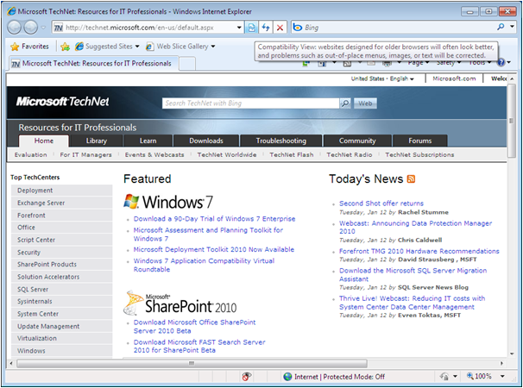
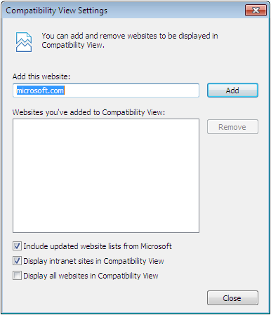
Compatibility View
Notes:
Explain the purpose of Compatibility View and use the screen shots on the slide to help you to explain how you would add sites to Compatibility View, if you cannot demonstrate. Discuss some of the Group Policy settings that can be configured on an Active Directory Domain.

Slide 6
Add-Ons
Add-ons are separate software components that interact with the basic functions of the web browser
Provide an interface between
  the browser and another software product
  the browser and a specific site on the Internet

Slide 7
Add-Ons
Toolbars and Extensions:
  Enable the browser to open and manipulate Web sites or file types that IE does not support natively
  Some applications add their own toolbars to IE, enabling you to work with their documents within an IE session

Slide 8
Add-Ons
Search Providers - Enable the user to perform searches directly from the IE interface using search engines on the Internet or the local network
Accelerators - Enable users to send text or other media they select in an IE browser window to another application
InPrivate Filtering - Enables you to import and export XML files containing InPrivate

Slide 9
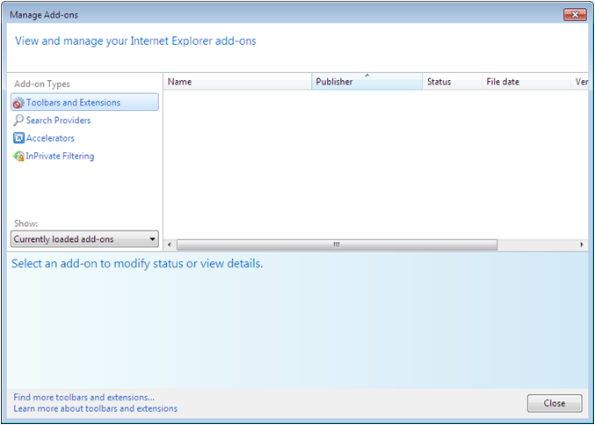
Managing Add-Ons
Notes:
Discuss the 4 types of add-ons supported by IE.

Slide 10
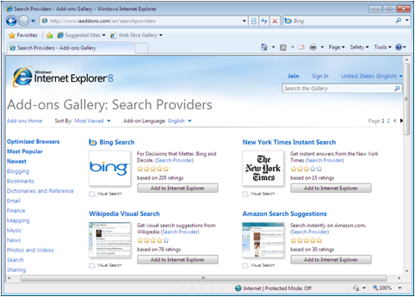
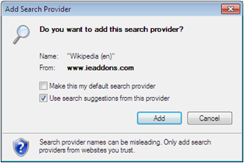
Configuring Search Options
Notes:
Explain that Bing is Microsoft’s default Search Provider when you perform searches in IE. You can add more search providers and select a different default Search providers are Add-ons.

Slide 11
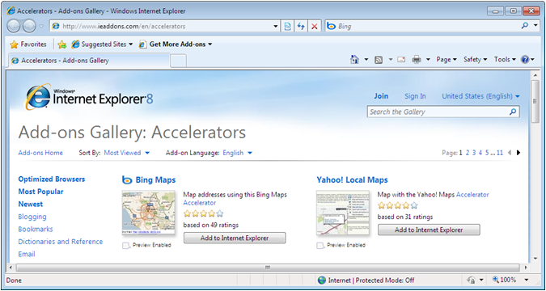
Configuring Accelerators
Notes:
Accelerators are another add-on that will allow you to send content to other resources, such as a blog, or to find it on a map. The above screen allows you select other Accelerators to add to IE. The use of Accelerators can also be controlled by Group Policy on an AD DS.

Slide 12
RSS Feeds
RSS feeds simplifies the process of delivering updated content from Web sites that provide frequently changing content to designated users
The whole point of an RSS feed is to eliminate the need for users to open multiple Web sites and browse for new content
You must subscribe to RSS feeds.
Subscription is the term used to refer to the process of configuring the RSS client to receive transmissions from a particular site

Slide 13
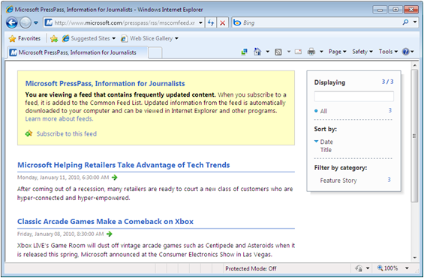
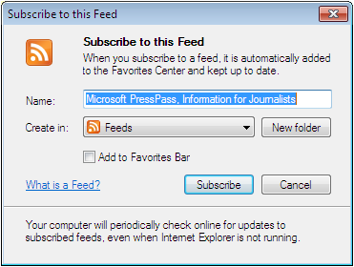
Configuring RSS Feeds
Notes:
RSS Feeds allow users to subscribe to sites with frequently changing content. This allows them to see the new content without having to go to each site. Use the RSS Feeds button in IE (turns RED when a feed is available), and then you can view the content at any time.

Slide 14
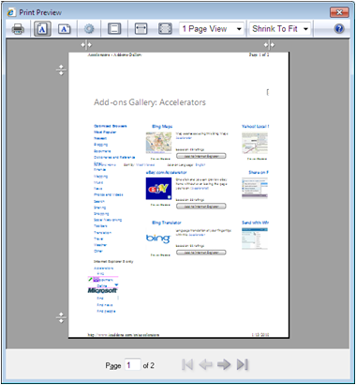
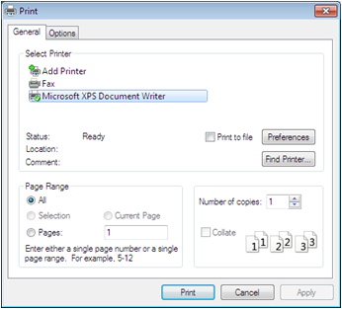
Printing with IE
Notes:
IE has had problems printing web pages in the past (text cut off). With IE8, there is a Print Preview page will allows users greater flexibility in viewing and formatting pages to be printed.

Slide 15
Securing Internet Explorer
Protected Mode
Security Zones
SmartScreen Filter
InPrivate Mode
Pop-Up Blocker
Privacy Settings
Browsing with Certificates
Notes:
IE 8 includes a number of important security enhancements. These are the topics that will be discussed on the following screens.

Slide 16
Understanding Protected Mode
Prevents attackers from accessing vital system components
Runs IE with highly reduced privileges
Can only write data to low integrity disk locations, like the Temporary Internet Files folder, and History, Cookies, and Favorites
Notes:
Explain Protected Mode and why this is a good defense against attackers coming through a web browser connection. The Protected Mode only works with IE8 running on Vista or Windows 7, not XP. Some older web-based applications may not run properly in Protected Mode. You can use Compatibility Logging to see what applications are not running properly and you can Move the site to the Trusted Sites zone, Disable Protected Mode in IE, or Modify the Application (difficult).

Slide 17
Security Zones
Internet
  All Web sites that are not listed in the other three zones fall into this zone
  Sites in the Internet zone run in protected mode and have minimal access to the computer drives and configuration settings

Slide 18
Security Zones
Local Intranet
  IE automatically detects sites that originate from the local intranet and places them in this zone
  Sites in this zone do not run in protected mode and have significant access to the system

Slide 19
Security Zones
Trusted Sites
  This zone provides the most elevated set of privileges and is intended for sites that you can trust not to damage the computer
  By default, there are no sites in this zone; you must add them manually.

Slide 20
Security Zones
Restricted Sites
  This zone has the most reduced set of privileges and runs in protected mode
  It is intended for Web sites that are known to be malicious, but which users still must access for some reason
  By default, there are no sites in this zone; you must add them manually

Slide 21
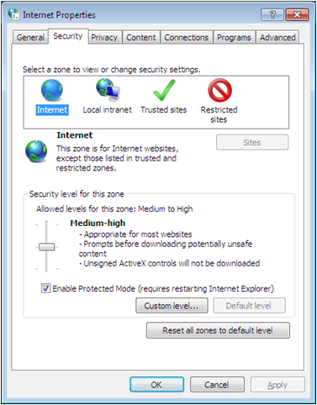
Configuring Security Zones
Notes:
Explain that with Web-Based applications becoming more common, companies will often use them, but many will require less restricted access to the system than what IE8 will provide in Protected Mode. To provide different levels of access to specific applications, IE divides the addresses accessible with the webbrowser into security zones. Describe each of the 4 zones.

Slide 22
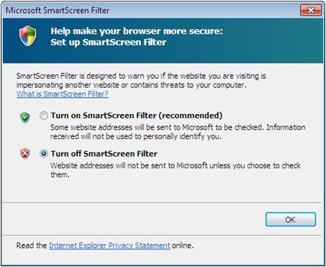
Configuring the SmartScreen Filter
Warns users of potential phishing Web sites
Online lookup of phishing sites
Online lookup of download sites
Onsite analysis
Notes:
Discuss Social Engineering and Phishing. The SmartScreen Filter examines traffic for evidence of Phishing activity and displays a warning to the user. Describe the 3 techniques used by the SmartScreen Filter to identify potential phishing websites.

Slide 23
Using InPrivate Mode
Enables you to surf the Internet without leaving any record of your activities
InPrivate Browsing - enables you to surf the Internet without leaving any record of your activities.
InPrivate Filtering - Prevents third-party Web sites from compiling information about an IE users browsing practices.
Notes:
Discuss the type of information that is typically gathered as users browse the Internet (temporary files, cookies and browsing history). Define what InPrivate Mode does for the user and explain the two technologies listed on the screen.

Slide 24
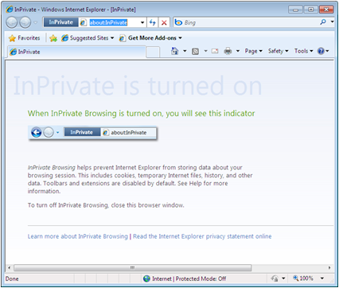
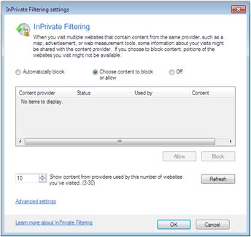
Using InPrivate Mode
Notes:
Discuss the type of information that is typically gathered as users browse the Internet (temporary files, cookies and browsing history). Define what InPrivate Mode does for the user and explain the two technologies listed on the screen.

Slide 25
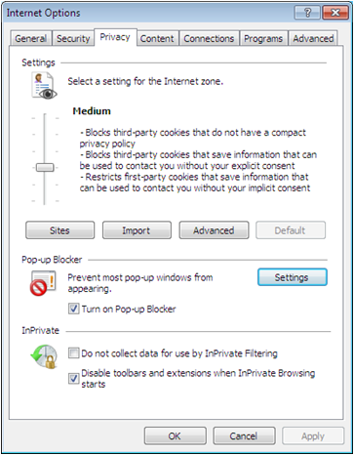
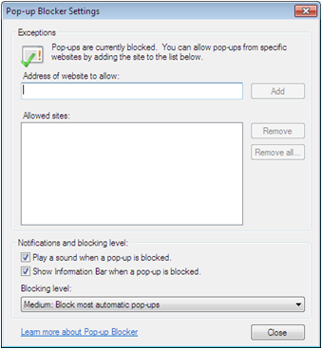
Configuring Pop-Up Blocker
Notes:
Pop-up windows are now a fact of Internet web browsing. Some pop-ups are useful web site controls, most are simply annoying advertisements, and a few can even be dangerous sources of spyware or other malicious programs. Internet Explorer includes a pop-up blocker that you can configure to suppress some or all pop-ups.

Slide 26
Configuring Privacy Settings
Cookie – A file containing information about you or your web-surfing habits
Use privacy settings to limit the ability of Web sites to create cookies
Notes:
Discuss good and potentially bad uses of cookies and that some people are uncomfortable with outside parties saving data on their drives for their own purposes.

Slide 27
SSL Secure Socket Layer
the protocol that most Web sites use when establishing secure connections with clients over the Internet
SSL communication is based on the exchange of digital certificates
A digital certificate is a credential, issued by a trusted parry that confirms the identity of the web server and enables the client and the server to exchange encrypted traffic

Slide 28
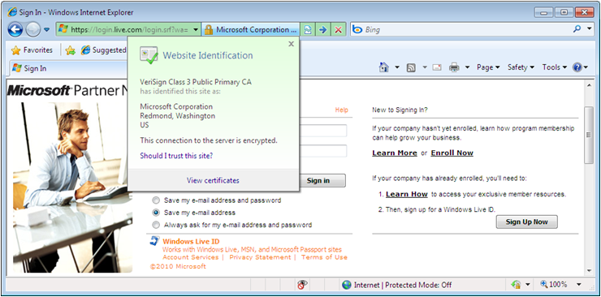
Browsing with Certificates
Notes:
Describe SSL and how they are based on a PKI that come from a CA. When a site is secured, a gold lock appears in the address bar and you can click on the lock to see certificate information.

Slide 29
Configuring application compatibility
Notes:
One example of these features, data execution prevention (DEP), prevents applications from executing code in certain areas of memory. Another, mandatory integrity control (MIC), defines four integrity levels that Windows assigns to running processes, which specify the amount of access that the processes receive to system resources. As a result of features like these, some programs that run perfectly well in older versions of Windows, particularly Windows XP and earlier, cannot run on Windows 7.

Slide 30
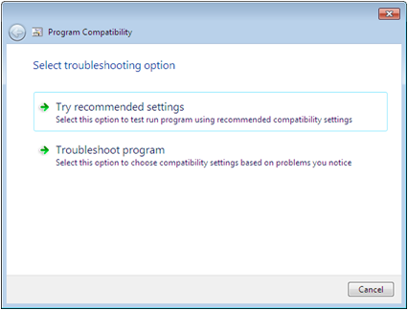
Troubleshooting Program Compatibility
Program Compatibility Troubleshooter
Tries to determine why an application is not running properly and gives you two options
Notes:
Describe the Program Compatibility Troubleshooter Program and explain the two options shown on the screen shot.

Slide 31
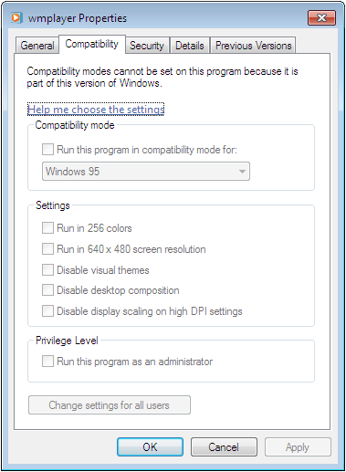
Setting Compatibility Modes
Can set compatibility modes manually through the executable’s Properties sheet
Notes:
Explain the process of setting an executable’s compatibility mode manually, meaning instead of using the Troubleshooter discussed in the last slide.

Slide 32
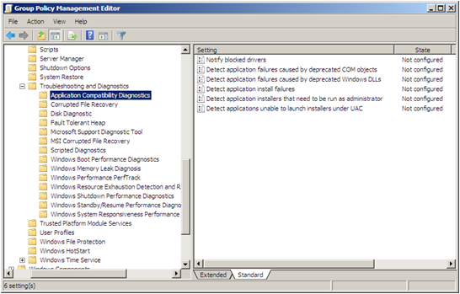
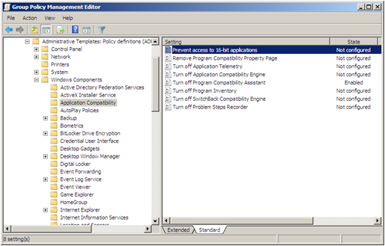
Configuring Application Compatibility Policies
Notes:
Discuss how enterprise network administrators would usually manage compatibility issues themselves and prefer that end-users do not see the compatibility warnings and try to configure compatibility issues themselves. Group policy can be used to suppress the compatibility warnings, and also can limit users’ access to compatibility mode controls. The two screen shots on the slide display settings for Application Compatibility Diagnostics and Application Compatibility. You can discuss a couple of the options.

Slide 33
Using the Application Compatibility Toolkit
The Application Com2tatibiliry Toolkit (ACT) 5.5 is available as a free download from the Microsoft Download Center
Application Compatibility Manager
Compatibility Administrator
Internet Explorer Compatibility Test tool
Setup Analysis tool
Standard User Analyzer
Notes:
Describe how the ACT is a collection of programs that enables administrators to gather information about incompatibilities between specific applications and Windows 7, and create customized solutions that enable those applications to run. It is a free download from the MS Download Center. Introduce the tools that will be discussed in the upcoming slides.

Slide 34
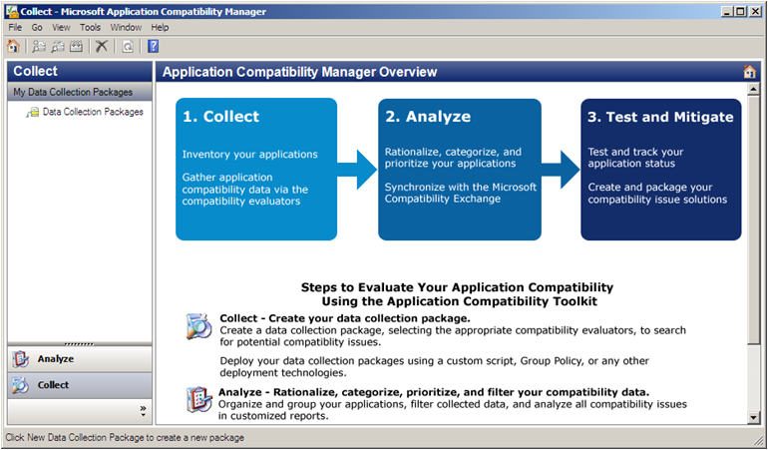
Application Compatibility Manager
Notes:
Designed primarily to help administrators ensure application compatibility for large-scale Windows 7 deployments, Application Compatibility Manager is a tool, shown in the screen shot, that gathers compatibility information and uses it to test your applications for compatibility issues. Describe the three basic steps shown on the screen.

Slide 35
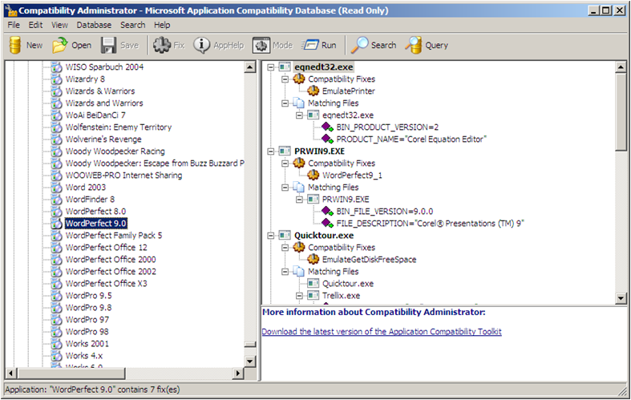
Compatibility Administrator
Notes:
Compatibility Administrator, as shown in the screen shot, is a central clearing house for solutions to known compatibility problems for hundreds of commercial Windows 7 applications. When you select an application in the left pane, the right pane lists existing compatibility fixes.

Slide 36
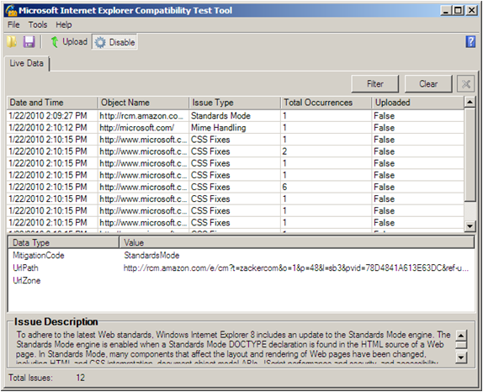
Internet Explorer Compatibility Test Tool
Notes:
The Internet Explorer Compatibility Test Tool is a specialized program that collects compatibility information for web pages and web-based applications. Unlike the Application Compatibility Manager, this is a real time tool that examines the compatibility of the web sites you access with Internet Explorer 8.
To use the Internet Explorer Compatibility Test Tool, you simple run the program, click enable, and use Internet Explorer to access the sites you want to test. An icon appears in the IE status bar, indicating that Internet Explorer compatibility evaluation logging is turned on, and log entries begin to appear in the tool’s Live Data window,

Slide 37
Setup Analysis Tool
Logging tool to analyze application setup programs for compatibility issues:
  Installation of kernel mode drivers
  Installation of 16-bit components
  Installation of Graphical Identification and Authentication DLLs
  Changes to files or registry keys that exist under Windows Resource Protection
Notes:
Describe the purpose of the Setup Analysis Tool.

Slide 38
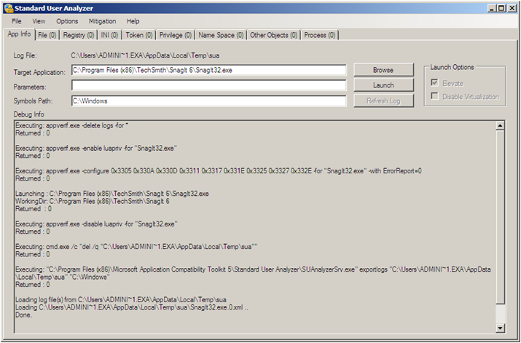
Standard User Analyzer
Notes:
The Standard User Analyzer is a tool that examines applications for compatibility issues caused by the User Account Control (UAC) feature of Windows 7. UAC can prevent applications from accessing resources that were available to them in previous Windows versions. The Standard User Analyzer identifies these resources, using either a manual or wizard-based format.

Slide 39
Using Windows XP Mode
Creates a virtual machine running Windows XP on your Windows 7 system
Used for applications that will not run any other way
Free download from Microsoft
Has extensive hardware requirements
Notes:
Describe Windows XP Mode and its requirements.

Slide 40
Configuring Application Restrictions
Notes:
Restricting the applications that users can run on their computers is one step towards creating a consistent workstation environment. Workstations that are identically configured are easier to support and limit the possibility of malware infiltration.
Windows 7 supports two mechanisms for restricting application, both of which you can deploy using Group Policy settings: software restriction policies and AppLocker. These mechanisms are discussed in the following slides.

Slide 41
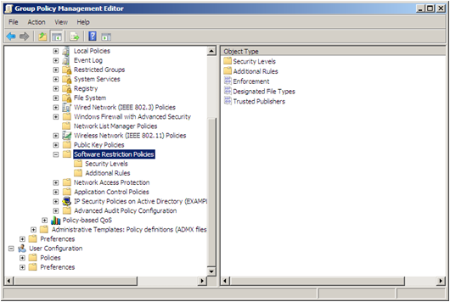
Using Software Restriction Policies
Rules that specify which applications users can run
Notes:
Introduce Software Restriction Policies. Note that they have been around for a long time. Policies can be set for workstations running different operating systems, like XP and Vista and Windows 7. Rules can only be created manually and individually.

Slide 42
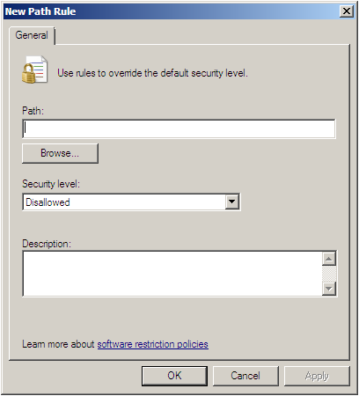
Creating Rules
Certificate rules
Hash rules
Network zone rules
Path rules
Default rule
Notes:
Describe the different types of rules that can be created.

Slide 43
Configuring Rule Settings
The three possible settings:
Disallow
Basic User
Unrestricted
Most restrictive and secure way is to Disallow all applications and then create Unrestricted rules for the applications you want users to run
Notes:
Describe the 3 rule settings and how to create a secure environment. Also discuss resolving conflicts.

Slide 44
Using AppLocker
New feature in Windows 7 Enterprise and Ultimate to create application restrictions more easily
Application Control Policies
Creation of rules is easier - Wizard-based
Only applies to Windows 7 and Windows Server 2008 R2
Notes:
Introduce AppLocker and describe why it is better than software restriction policies and what its disadvantages are.

Slide 45
Understanding Rule Types
Executable rules - Contains rules that apply to files with .exe and .com extensions
Windows Installer rules - Contains rules that apply to Windows Installer packages with .msi and .msp extensions.
Script rules - Contains rules that apply to script files with .ps1, .bat, .cmd, .vbs, and.js extensions.
Notes:
Describe the rule types and the criteria used to allow or block access to specific resources.

Slide 46
Understanding Rule Types
Criteria for resource access:
Publisher - Identifies code-signed applications by means of a digital signature extracted from an application file
Path - Identifies applications by specif ing a file or folder name
File Hash - Identifies applications based on a digital fingerprint that remains valid even when the name or location of the executabie file changes
Notes:
Describe the rule types and the criteria used to allow or block access to specific resources.

Slide 47
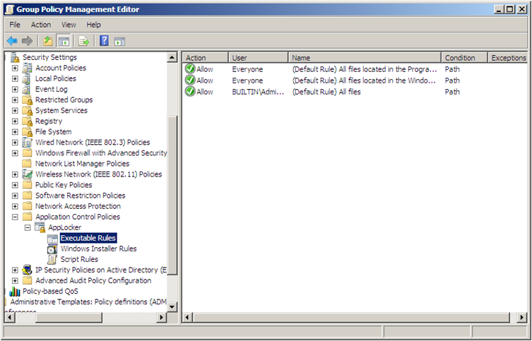
Creating Default Rules
Notes:
By default, AppLocker blocks all executables, installer packages, and scripts, except for those specified in Allow rules. Therefore, to use AppLocker, you must create rules that enable users to access the files needed for Windows and the system’s installed applications to run. The simplest way to do this is to right-click each of the three rules containers and select Create Default Rules from the context menu.
The default rules for each container, as shown in the screen shot, are standard rules that you can replicate, modify, or delete as necessary. You can also create your own rules instead, as long as you are careful to provide access to all the resources the computer needs to run Windows.

Slide 48
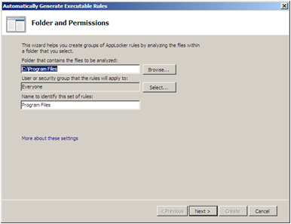
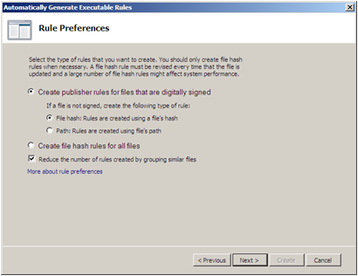
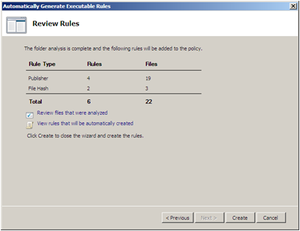
Creating Rules Automatically
Notes:
Describe the great advantage of AppLocker is that when you create a new rule, the wizard starts automatically.

Slide 49
Creating Rules Manually
Wizard prompts you for the following information:
  Action
  User or group
  Conditions
  Exceptions
Notes:
Describe the different pieces of information that the wizard prompts the administrator for.

Slide 50
Skills Summary
Compatibility View, in IE8, enables the browser to display older pages properly.
Add-ons are separate software components that interact with the basic functions of the web browser.
Accelerators enable users to send content to other resources in the form of applications running on the computer or other sites on the Internet.
Protected mode is a way to run Internet Explorer 8 with highly reduced privileges.
Notes:
Review the Skill Summary to wrap up your lesson.

Slide 51
Skills Summary (cont.)
A SmartScreen Filter examines traffic for evidence of phishing activity and displays a warning to the user if it finds any.
Security zones have different sets of privileges to provide levels of access.
A gold lock appears in the address bar of IE when a user connects to a secure site (SSL).
In Windows 7, administrators must take measures to ensure the compatibility of their legacy applications.

Slide 52
Skills Summary (cont.)
Application Compatibility Toolkit is for application incompatibilities that are not readily solvable with the Windows 7 compatibility mode settings.
Software restriction policies enable administrators to specify the programs that are allowed to run on workstations.
AppLocker enables administrators to create application restriction rules more easily.

